Slide 1
안드로이드 실무 3주차 과제
1901055 정시철

Slide 2
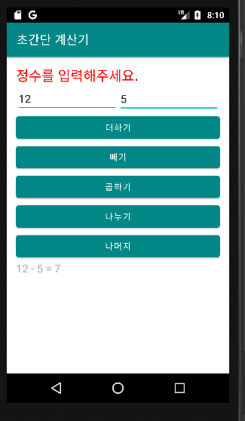
Report 1 초간단 계산기
package com.example.report1; import androidx.appcompat.app.AppCompatActivity; import android.os.Bundle; import android.view.View; import android.widget.Button; import android.widget.EditText; import android.widget.TextView; import android.widget.Toast; public class MainActivity extends AppCompatActivity { int result; @Override protected void onCreate(Bundle savedInstanceState) { super.onCreate(savedInstanceState); setContentView(R.layout.activity_main); EditText data1 = findViewById(R.id.data1); EditText data2 = findViewById(R.id.data2); Button add = findViewById(R.id.add); Button sub = findViewById(R.id.sub); Button mul = findViewById(R.id.mul); Button div = findViewById(R.id.div); Button rem = findViewById(R.id.rem); TextView answer = findViewById(R.id.answer); add.setOnClickListener(new View.OnClickListener() { @Override public void onClick(View view) { String a = data1.getText().toString(); String b = data2.getText().toString(); if(a.equals("")||a.equals("")){ Toast.makeText(getBaseContext(),"숫자를 입력해주세요.",Toast.LENGTH_SHORT).show(); } else{ result = Integer.parseInt(String.valueOf(a))+Integer.parseInt(String.valueOf(b)); answer.setText(a+" + "+b+" = "+result); } } }); sub.setOnClickListener(new View.OnClickListener() { @Override public void onClick(View view) { String a = data1.getText().toString(); String b = data2.getText().toString(); if(a.equals("")||a.equals("")){ Toast.makeText(getBaseContext(),"숫자를 입력해주세요.",Toast.LENGTH_SHORT).show(); } else{ result = Integer.parseInt(String.valueOf(a))-Integer.parseInt(String.valueOf(b)); answer.setText(a+" - "+b+" = "+result); } } }); mul.setOnClickListener(new View.OnClickListener() { @Override public void onClick(View view) { String a = data1.getText().toString(); String b = data2.getText().toString(); if(a.equals("")||a.equals("")){ Toast.makeText(getBaseContext(),"숫자를 입력해주세요.",Toast.LENGTH_SHORT).show(); } else{ result = Integer.parseInt(String.valueOf(a))*Integer.parseInt(String.valueOf(b)); answer.setText(a+" * "+b+" = "+result); } } }); div.setOnClickListener(new View.OnClickListener() { @Override public void onClick(View view) { String a = data1.getText().toString(); String b = data2.getText().toString(); if(a.equals("")||a.equals("")){ Toast.makeText(getBaseContext(),"숫자를 입력해주세요.",Toast.LENGTH_SHORT).show(); } else if(b.equals("0")){ Toast.makeText(getBaseContext(),"0으로는 나눌 수 없습니다.",Toast.LENGTH_SHORT).show(); } else{ result = Integer.parseInt(String.valueOf(a))/Integer.parseInt(String.valueOf(b)); answer.setText(a+" / "+b+" = "+result); } } }); rem.setOnClickListener(new View.OnClickListener() { @Override public void onClick(View view) { String a = data1.getText().toString(); String b = data2.getText().toString(); if(a.equals("")||a.equals("")){ Toast.makeText(getBaseContext(),"숫자를 입력해주세요.",Toast.LENGTH_SHORT).show(); } else{ result = Integer.parseInt(String.valueOf(a))%Integer.parseInt(String.valueOf(b)); answer.setText(a+" % "+b+" = "+result); } } }); } }
<?xml version="1.0" encoding="utf-8"?> <LinearLayout xmlns:android="http://schemas.android.com/apk/res/android" xmlns:app="http://schemas.android.com/apk/res-auto" xmlns:tools="http://schemas.android.com/tools" android:layout_width="match_parent" android:layout_height="match_parent" android:padding="15dp" android:orientation="vertical" tools:context=".MainActivity"> <TextView android:layout_width="match_parent" android:layout_height="wrap_content" android:text="정수를 입력해주세요." android:textColor="#ff0000" android:textSize="10pt" /> <LinearLayout android:layout_width="match_parent" android:layout_height="wrap_content"> <EditText android:id="@+id/data1" android:layout_width="match_parent" android:layout_height="wrap_content" android:layout_weight="1" android:hint="숫자 1"> </EditText> <EditText android:id="@+id/data2" android:layout_width="match_parent" android:layout_height="wrap_content" android:layout_weight="1" android:hint="숫자 2"></EditText> </LinearLayout> <Button android:id="@+id/add" android:layout_width="match_parent" android:layout_height="wrap_content" android:text="더하기" /> <Button android:id="@+id/sub" android:layout_width="match_parent" android:layout_height="wrap_content" android:text="빼기" /> <Button android:id="@+id/mul" android:layout_width="match_parent" android:layout_height="wrap_content" android:text="곱하기" /> <Button android:id="@+id/div" android:layout_width="match_parent" android:layout_height="wrap_content" android:text="나누기" /> <Button android:id="@+id/rem" android:layout_width="match_parent" android:layout_height="wrap_content" android:text="나머지" /> <TextView android:layout_width="match_parent" android:layout_height="wrap_content" android:id="@+id/answer" android:textSize="8pt" android:textColor="#aaaaaa" android:text="결과 :"> </TextView> </LinearLayout>

Slide 3
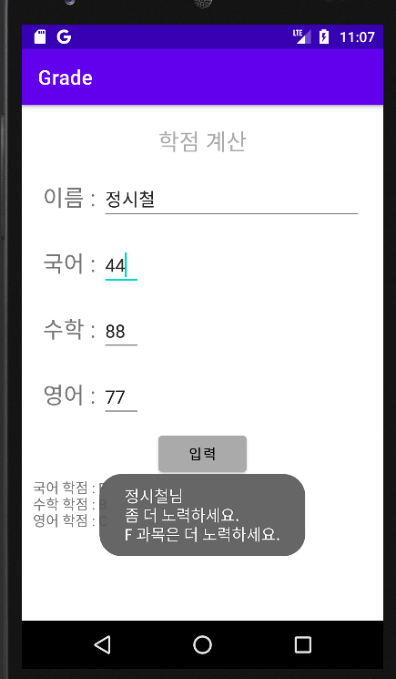
Report 2 학점 계산
<?xml version="1.0" encoding="utf-8"?> <LinearLayout xmlns:android="http://schemas.android.com/apk/res/android" xmlns:app="http://schemas.android.com/apk/res-auto" xmlns:tools="http://schemas.android.com/tools" android:layout_width="match_parent" android:layout_height="match_parent" android:orientation="vertical" android:padding="5pt" tools:context=".MainActivity"> <TextView android:layout_width="match_parent" android:layout_height="wrap_content" android:text="학점 계산" android:gravity="center" android:textColor="#aaaaaa" android:textSize="10pt" android:layout_margin="10dp"/> <LinearLayout android:layout_width="match_parent" android:layout_height="wrap_content" android:layout_margin="10dp"> <TextView android:layout_width="wrap_content" android:layout_height="wrap_content" android:textSize="10pt" android:text="이름 : "> </TextView> <EditText android:id="@+id/data0" android:layout_width="match_parent" android:layout_height="wrap_content" android:hint="이름을 입력해주세요."></EditText> </LinearLayout> <LinearLayout android:layout_width="match_parent" android:layout_height="wrap_content" android:layout_margin="10dp"> <TextView android:layout_width="wrap_content" android:layout_height="wrap_content" android:textSize="10pt" android:text="국어 : "> </TextView> <EditText android:id="@+id/data1" android:layout_width="40dp" android:layout_height="wrap_content"> </EditText> </LinearLayout> <LinearLayout android:layout_width="match_parent" android:layout_height="wrap_content" android:layout_margin="10dp"> <TextView android:layout_width="wrap_content" android:layout_height="wrap_content" android:textSize="10pt" android:text="수학 : "> </TextView> <EditText android:id="@+id/data2" android:layout_width="40dp" android:layout_height="wrap_content"> </EditText> </LinearLayout> <LinearLayout android:layout_width="match_parent" android:layout_height="wrap_content" android:layout_margin="10dp"> <TextView android:layout_width="wrap_content" android:layout_height="wrap_content" android:textSize="10pt" android:text="영어 : "> </TextView> <EditText android:id="@+id/data3" android:layout_width="40dp" android:layout_height="wrap_content"> </EditText> </LinearLayout> <LinearLayout android:layout_width="match_parent" android:layout_height="wrap_content" android:gravity="center"> <Button android:id="@+id/input" android:backgroundTint="#aaaaaa" android:layout_width="wrap_content" android:layout_height="wrap_content" android:text="입력" android:textColor="@color/black"></Button> </LinearLayout> <TextView android:id="@+id/output" android:layout_width="wrap_content" android:layout_height="wrap_content"></TextView> </LinearLayout>
package com.example.report2; import androidx.appcompat.app.AppCompatActivity; import android.os.Bundle; import android.view.View; import android.widget.Button; import android.widget.EditText; import android.widget.TextView; import android.widget.Toast; public class MainActivity extends AppCompatActivity { int[] D = new int[3]; char[] Output = new char[3]; @Override protected void onCreate(Bundle savedInstanceState) { super.onCreate(savedInstanceState); setContentView(R.layout.activity_main); EditText d0 = findViewById(R.id.data0); EditText d1 = findViewById(R.id.data1); EditText d2 = findViewById(R.id.data2); EditText d3 = findViewById(R.id.data3); Button input = findViewById(R.id.input); TextView textView = findViewById(R.id.output); input.setOnClickListener(new View.OnClickListener() { @Override public void onClick(View view) { String data0 = d0.getText().toString(); String data1 = d1.getText().toString(); String data2 = d2.getText().toString(); String data3 = d3.getText().toString(); if (data1.equals("")||data2.equals("")||data3.equals("")){ Toast.makeText(getBaseContext(),"점수를 입력해주세요.",Toast.LENGTH_SHORT).show(); return; } else{ D[0] = Integer.parseInt(String.valueOf(data1)); D[1] = Integer.parseInt(String.valueOf(data2)); D[2] = Integer.parseInt(String.valueOf(data3)); for (int i = 0; i < 3; i++){ if (D[i] > 90) Output[i]= 'A'; else if (D[i]<=90 && D[i]>80) Output[i]= 'B'; else if (D[i]<=80 && D[i]>70) Output[i]= 'C'; else if (D[i]<=70 && D[i]>60) Output[i]= 'D'; else Output[i]= 'F'; } textView.setText("국어 학점 : "+Output[0]+"\n수학 학점 : "+Output[1]+"\n영어 학점 : "+Output[2]); if(Output[0]=='F'||Output[1]=='F'||Output[2]=='F'){ Toast.makeText(getBaseContext(),data0+"님\n좀 더 노력하세요.\nF 과목은 더 노력하세요.",Toast.LENGTH_SHORT).show(); } else if(D[0]<80||D[1]<80||D[2]<80){ Toast.makeText(getBaseContext(),data0+"님\n좀 더 노력하세요.",Toast.LENGTH_SHORT).show(); } else{ Toast.makeText(getBaseContext(),data0+"님\n잘 하셨습니다!",Toast.LENGTH_SHORT).show(); } return; } } }); } }
너무 소스 코드가 길어져서 간략하게 줄여보았습니다.
배열과 for문을 사용했습니다.
아무것도 안 썼을때는 toast가 나오도록 추가했습니다.

Slide 4
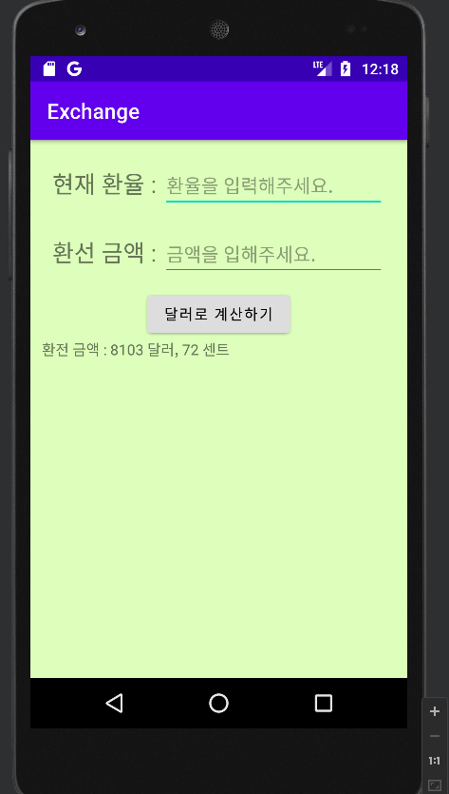
Report 3 환율 계산
package com.example.report3; import androidx.appcompat.app.AppCompatActivity; import android.os.Bundle; import android.view.View; import android.widget.Button; import android.widget.EditText; import android.widget.TextView; import android.widget.Toast; public class MainActivity extends AppCompatActivity { double a,result; int b,dollar,cent; @Override protected void onCreate(Bundle savedInstanceState) { super.onCreate(savedInstanceState); setContentView(R.layout.activity_main); EditText d1 = findViewById(R.id.data1); EditText d2 = findViewById(R.id.data2); Button input = findViewById(R.id.input); TextView textView = findViewById(R.id.output); input.setOnClickListener(new View.OnClickListener() { @Override public void onClick(View view) { String data1 = d1.getText().toString(); String data2 = d2.getText().toString(); if (data1.equals("")||data2.equals("")){ Toast.makeText(getBaseContext(),"데이터를 입력해주세요.",Toast.LENGTH_SHORT).show(); } else{ a = Double.parseDouble(String.valueOf(data1)); b = Integer.parseInt(String.valueOf(data2)); result = b/a; dollar = (int) result; cent = (int) ((result-(double) dollar)*100); textView.setText("환전 금액 : "+dollar+" 달러, "+cent+" 센트"); } } }); } }
<?xml version="1.0" encoding="utf-8"?> <LinearLayout xmlns:android="http://schemas.android.com/apk/res/android" xmlns:app="http://schemas.android.com/apk/res-auto" xmlns:tools="http://schemas.android.com/tools" android:layout_width="match_parent" android:layout_height="match_parent" android:orientation="vertical" android:padding="5pt" android:background="#ddffbb" tools:context=".MainActivity"> <LinearLayout android:layout_width="match_parent" android:layout_height="wrap_content" android:layout_margin="10dp"> <TextView android:layout_width="wrap_content" android:layout_height="wrap_content" android:textSize="10pt" android:text="현재 환율 : "> </TextView> <EditText android:id="@+id/data1" android:layout_width="match_parent" android:layout_height="wrap_content" android:hint="환율을 입력해주세요."></EditText> </LinearLayout> <LinearLayout android:layout_width="match_parent" android:layout_height="wrap_content" android:layout_margin="10dp"> <TextView android:layout_width="wrap_content" android:layout_height="wrap_content" android:textSize="10pt" android:text="환선 금액 : "> </TextView> <EditText android:id="@+id/data2" android:layout_width="match_parent" android:layout_height="wrap_content" android:hint="금액을 입해주세요."></EditText> </LinearLayout> <LinearLayout android:layout_width="match_parent" android:layout_height="wrap_content" android:gravity="center"> <Button android:id="@+id/input" android:backgroundTint="#dddddd" android:layout_width="wrap_content" android:layout_height="wrap_content" android:text="달러로 계산하기" android:textColor="@color/black"></Button> </LinearLayout> <TextView android:id="@+id/output" android:layout_width="wrap_content" android:layout_height="wrap_content"></TextView> </LinearLayout>
#00ff00 완전한 초록색은 겉보기에 조금 불편해서 보기 좋은 색감으로 바꿨습니다.
아무것도 안 썼을때는 toast가 나오도록 추가했습니다.

